Slide 1


Estimating population density from remote sensing and microcensus
Sohan Seth, Isaac Neal
School of Informatics

Slide 2

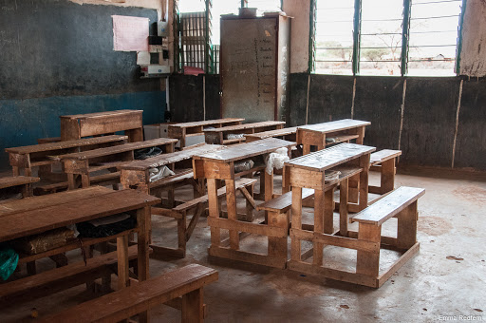
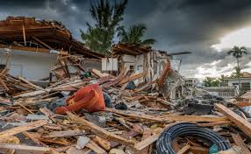

Population estimation
Notes:
Knowing the population density or how many people live in a certain region is crucial for making policies. For example, we need to know where people are to distribute vaccine or disaster relief, or to build facilities, or monitor sustainable development goals indicators.
Population can be estimated reliably through census. However, census lacks the spatial and temporal resolution for these tasks since it is conducted every 10 years or less. On the other hand, population in a region can change very quickly due to migration or either natural, e.g., flood or man-made calamities, e.g., war.
Thus, we need to tools to monitor population at with sufficient spatial and temporal resolution.

Slide 3
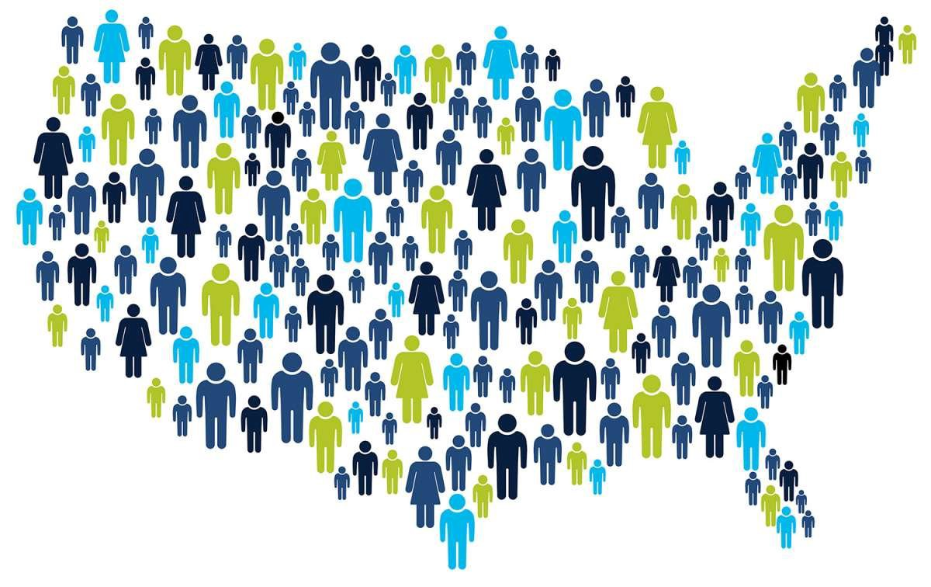
Population estimation
Notes:
Knowing the population density or how many people live in a certain region is crucial for making policies. For example, we need to know where people are to distribute vaccine or disaster relief, or to build facilities, or monitor sustainable development goals indicators.
Population can be estimated reliably through census. However, census lacks the spatial and temporal resolution for these tasks since it is conducted every 10 years or less, and it can be adversely affected by socio-political reason.
On the other hand, population in a region can change very quickly due to migration or either natural, e.g., flood or man-made calamities, e.g., war.
Thus, we need tools to monitor population with sufficient spatial and temporal resolution, say every year.

Slide 4
Top-down / population disaggregation
Notes:
A popular approach that has been used frequently in the literature is the top-down approach or population disaggregation where the idea is that if we have reliable knowledge of how many people live in a region, e.g., a district, then we can use remote sensing attributes, e.g., night time light, to distribute or disaggregate these aggregates to finer resolution.
The problem with this is that the aggregated population is not reliable since they are usually a projection from last census.

Slide 5
Bottom-up / census independent approach
Notes:
A relatively new approach to this problem which is gaining some momentum is the bottom-up approach or the census-independent population estimation. Here the idea is to rely on microcensus to explicitly collect data on population at a local level (primary sampling unit), and then use remote sensing attributes to project this to national level.
Like top-down, bottom-up approach has its challenges, e.g., collecting microcensus data is more expensive that top-down although cheaper than full census. $2 per person in Mozambique.
However, it provides ground truth information can be used to adjust population estimates with sufficient spatial and temporal resolution.
Bottom-up approaches however is in its infancy, and we will describe our ongoing work in Mozambique with a retrospective mircocensus data.

Slide 6

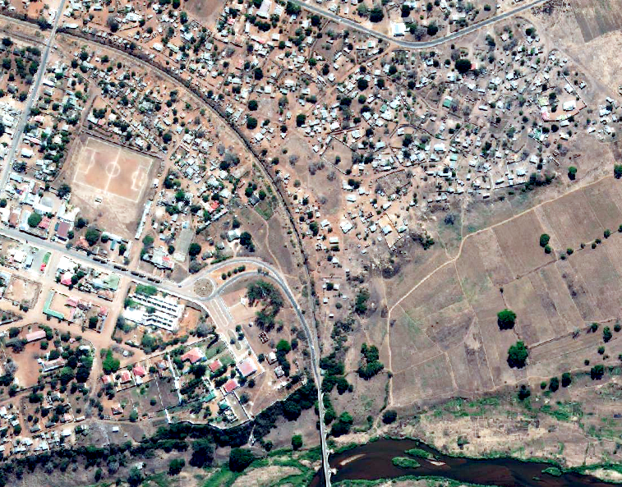
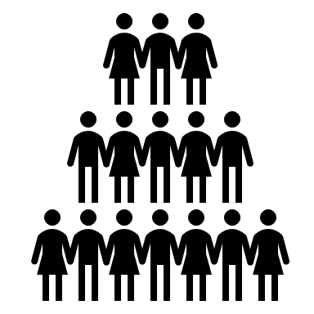


Our focus
Find ‘sustainable’ approaches, in terms of data
Reduce human supervision, in terms of methods
Notes:
Our primary goal is to estimate population over 100x100 sqm grid from microcensus measurements using remote sensing data.
There are few existing works addressing this problem, however, they often rely on human supervision for extracting remote sensing attributed, e.g., annotating buildings, finding roof type, etc.
Can we use use data that is readily available or will be available on a regular basis? Can we only rely on public databases?
Can we reduce human supervision using transfer learning?

Slide 7
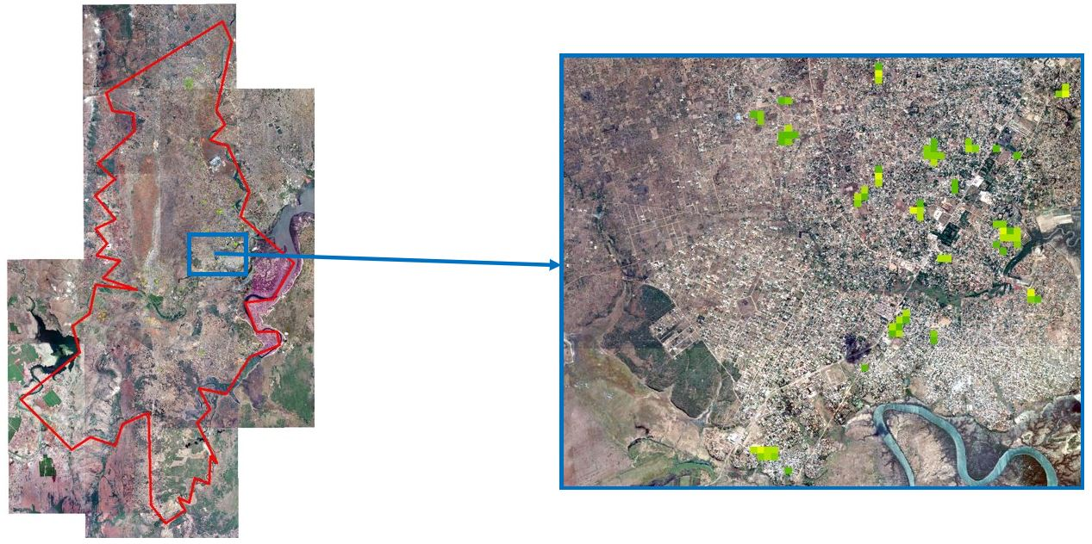
Data
Microcensus:
Two districts in Mozambique Boane and Magudo (288 grid cells)
Proprietary:
0.5m resolution satellite images for extracting building footprints
Publicly available:
Road information from OSM (vector shapefiles, volunteer annotation)
Land cover classification (100m resolution, updated yearly) [ESA]
Night-time light information (750m resolution, updated daily)
LandSat information [Bands, NDVI, NDWI] (30m resolution, every 8 days)
High Resolution Settlement Layer (HRSL) binary settlement map (30m resolution, 2015) [Facebook]
Notes:
We have microcensus data from two districts in Mozambique, and we are focusing on rural and semi-rural areas.
The figure shows tthe location at which microcensus is conducted.
Although PSUs have irregular boundaries we convert everything to 100x100 sqm grid and use them as training sample.
We have limited retrospective data, and therefore we are relying on hand-crafted features to find baseline results.

Slide 8
Data
Microcensus:
Two districts in Mozambique Boane and Magudo (PSU -> 288 grid cells)
Publicly available:
Road information from OSM (volunteer annotation)
Land cover classification (100m resolution, updated yearly) [ESA]
Night-time light information (750m resolution, updated daily)
LandSat information [Bands, NDVI, NDWI] (30m resolution, every 8 days)
High Resolution Settlement Layer (HRSL) binary settlement map (30m resolution, 2015) [Facebook]
Proprietary:
0.5m resolution satellite images for extracting building footprints (4 days ideally)
Notes:
From remote sensing perspective we rely on publicly available data and convert all data to 100x100 grids as well.
Road data from OSM, assuming that road can distance to road is informative of population.
Land-cover classification divides the land 13 classes, e.g,, forest, water, urban etc.
NTL is undated daily but has poor resolution and might not be informative in rural area without light.
LandSat is updated frequently and gives us information on the land cover as well.
HRSL was released in 2015 by Facebook and provides information on where settlement exists.
We also use high resolution satellite images that can be updated every 4 days in ideal condition, and enough to see small objects such as buildings, shadow, car etc.

Slide 9
Data
Microcensus:
Two districts in Mozambique Boane and Magudo (PSU -> 288 grid cells)
Publicly available:
Road information from OSM (volunteer annotation)
Land cover classification (100m resolution, updated yearly) [ESA]
Night-time light information (750m resolution, updated daily)
LandSat information [Bands, NDVI, NDWI] (30m resolution, every 8 days)
High Resolution Settlement Layer (HRSL) binary settlement map (30m resolution, 2015) [Facebook]
Proprietary:
0.5m resolution satellite images for extracting building footprints
Notes:
We also use high resolution satellite images that can be updated every 4 days in ideal condition, and enough to see small objects such as buildings, shadow, car etc.
We use these images to extract building footprints.

Slide 10
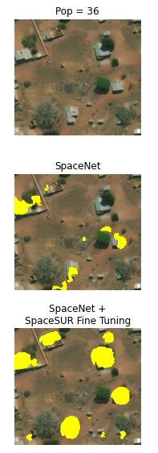
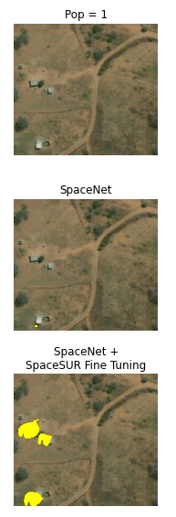
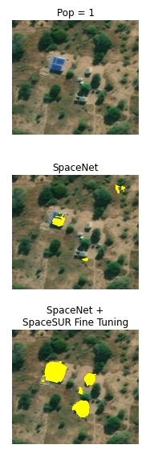
Building footprint
SpaceNet is a publicly available building footprint dataset covering a large area in Brazil
Pretrained model (U-Net) without additional human labelling in Mozambique using SpaceNet
Retrained proof of concept model (1 epoch) on ‘dot’ labels (SpaceSUR and GroundWork)
We don’t need exact estimate: our goal is population not footprint
Notes:
Unfortunately, however, we do not have building footprint annotations from Mozambique.
We use publicly available SpaceNet dataset from Brazil to train a UNet to detect buildings.
We also had some dot annotations that were manually curated in Mozambique (in the non-surveyed region) which we used fine-tune the model.
Our goal is not to find the best building footprints but a rough estimate of the area will help,

Slide 11
Results
MeAPE: Median absolute percentage error
MeAE: Median absolute error
AggPE: Aggregated percentage error
Notes:
We trained GLM and random forest models on different combinations of the features and used cross validation to compare their performance.
We divided the data spatially in 4 regions to create 4 fold cross-validation.
We observe that building footprint is the most relevant information in predicting population, i.e., SpaceSUR only where only building footprints were used in predict population. But these used fine tuning of the model.
This leads to the best MeAE. The MeAPE is high since the ground truth population is low in rural area. However, this error is tolerable since we are OK with having low, medium and high population.

Slide 12
Results
MeAPE: Median absolute percentage error
MeAE: Median absolute error
AggPE: Aggregated percentage error
Notes:
Network trained with SpaceNet only performs much worse.
Using only public dataset performed worse as well.
This is informative since these results do not require additional annotation. However, we observe that the features we are using and the way we are using are not informative enough.

Slide 13
Results
MeAPE: Median absolute percentage error
MeAE: Median absolute error
AggPE: Aggregated percentage error
Notes:
But performance improved when these were used together. However, there is a gap between this and using additional annotation, and this is what we aim to improve through better modelling.
Building footprint is the most relevant feature, and we are working on making it better.

Slide 14
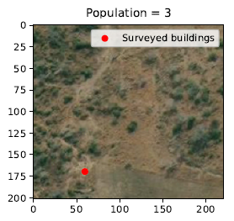
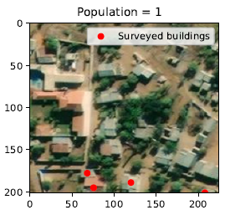


Challenges
The study is limited by the number of samples we have. We discarded many samples as remote sensing and microcensus do not match.
No buildings
Non-zero
population
Low
population
Built up area
Notes:
We have to note that the number of samples we had in this study is quite low, and we also had to remove potential samples are outliers because we cannot validate our findings with them.
This happens because out microcensus and satellite didn't align. While microcensus was conducted in 2019, the satellite images were mosaic from 2018-2020, and things might change a lot during that time.
We observed that there are places where buildings were not sampled in a build up area or building were sampled where there were none.
Better survey data can resolve this issue.

Slide 15
Next
More microcensus data to validate the findings.
Improve pipeline for detecting building counts, individual areas, non-residential buildings, historic sites, buildings under construction and/or in ruins.
Use spatial correlation of local population
Better validation tools and evaluation metrics

Slide 16
Thanks
Isaac Neal (School of Informatics)
Gary Watmough (School of GeoSciences)
Mamadou Saliou Diallo (UNICEF)
Alex Hutchison (Data for Children Collaborative)

